Slide 1
Renewable Energy Sources

Slide 2
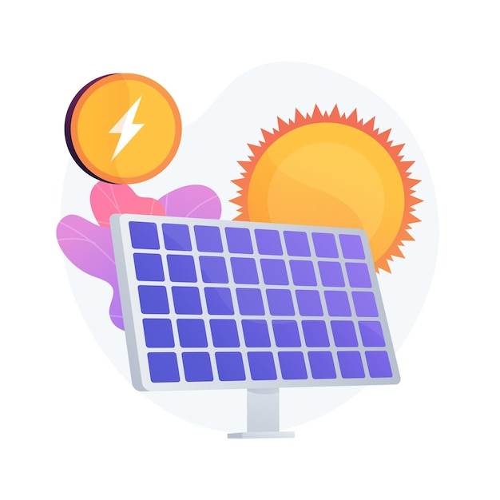
Solar energy

Slide 3
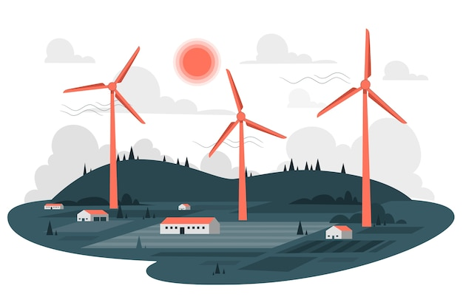
wınd energy

Slide 4
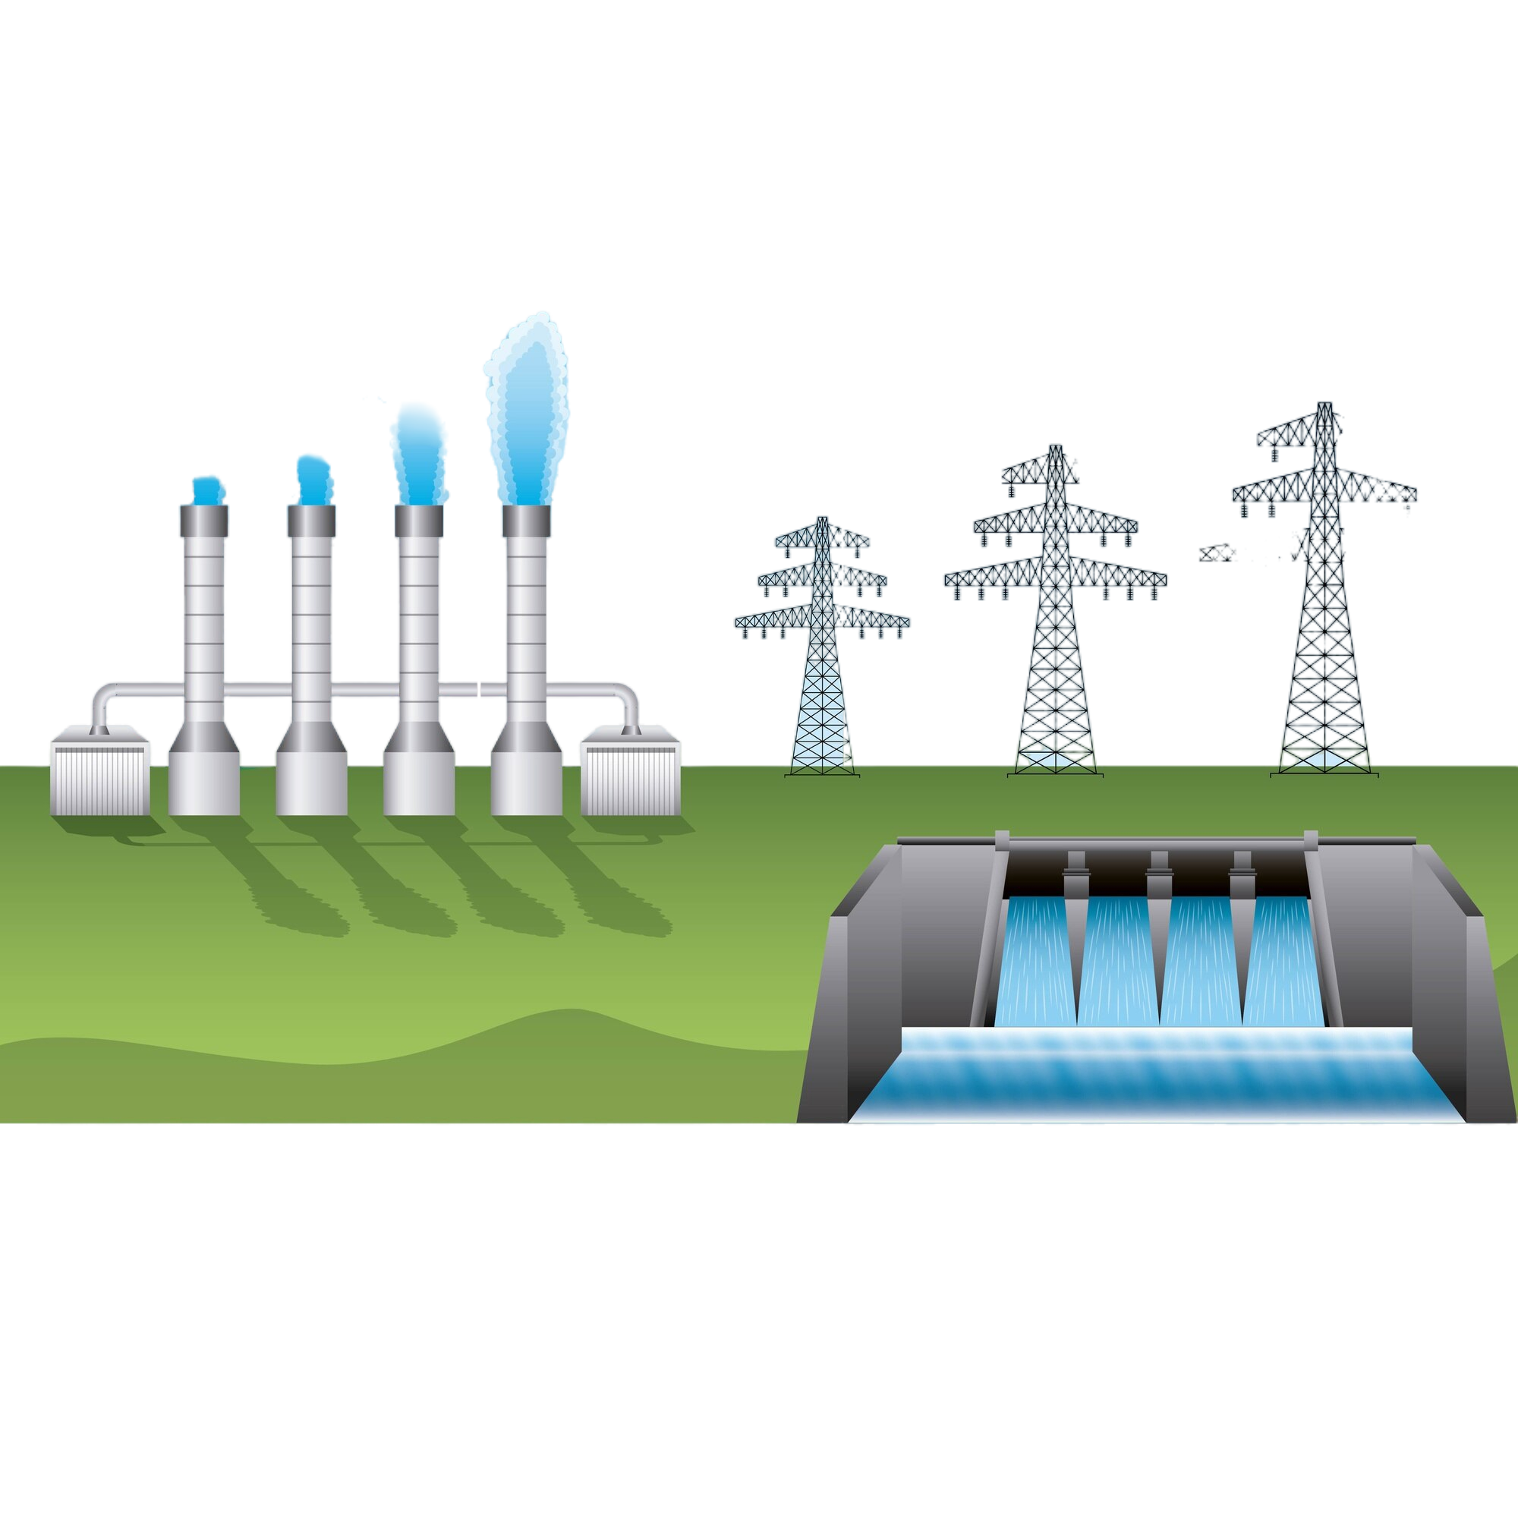
HYDRO energy

Slide 5
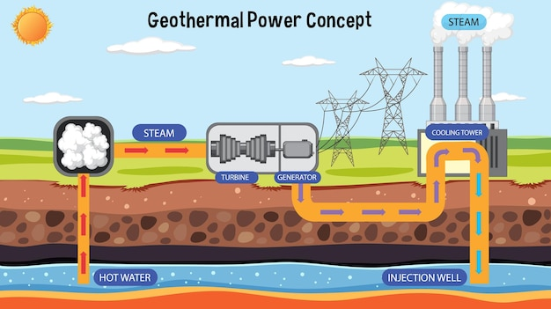
GEOTHERMAL energy

Slide 6
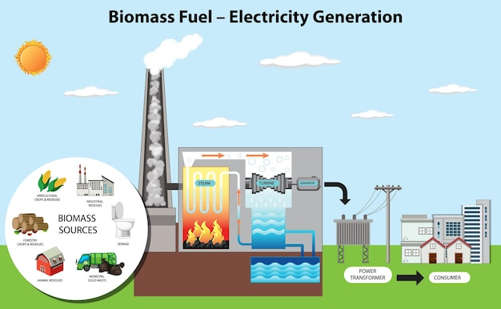
BIOMASS energy

Slide 7






Module: Ecological awareness
Sub-module: Environmental pollution
Topic: Renewable Energy Sources
Resource title: Presentation
Credits: APDNE
2023-1-BG01-KA220-SCH-000160813
All media are within the EU intellectual property law.
Funded by the European Union. Views and opinions expressed are however those of the author(s) only and do not necessarily reflect those of the European Union or the European Education and Culture Executive Agency (EACEA). Neither the European Union nor EACEA can be held responsible for them.

